Slide 1
Safety Expectations and Guidelines for Colleagues in Offices
Subhead (if necessary)
Presenter’s Name Here Title Here Date Here

Slide 2
Our Mission
We, Trinity Health, serve together in the spirit of the Gospel as a compassionate and transforming healing presence within our communities.
Our Core Values
Reverence
Justice Stewardship Integrity
Commitment to Those Who are Poor
Safety
Our Vision
As a mission-driven innovative health organization, we will become the national leader in improving the health of our communities and each person we serve. We will be the most trusted health partner for life.

Slide 3
Colleague safety is a top Trinity Health priority
Trinity Health reviews guidance and requirements from the Centers for Disease Control and Prevention (CDC), the Occupational Health and Safety Administration (OSHA), and other agencies to ensure we protect the health and well-being of all our colleagues
Requirements and expectations in response to COVID-19 have been created for your health and safety and the health and safety of those around you in our non-patient care office environments
Some may seem challenging, but this cautious approach will keep all of us safer!
Core Value of Safety We embrace a culture that prevents harm and nurtures a healing, safe environment for all.

Slide 4
Safety Expectations and Guidelines for Colleagues in Offices
Please read the guide if you have not already
Addresses requirements and expectations for working in a non-patient care office setting:
safely report to work
daily screening at identified check points
cleaning and disinfection of the environment workspaces and common use areas
hand hygiene
physical distancing
use of masks or face coverings
other practices to minimize exposure to COVID-19 and minimize chance of exposure in our workplaces

Slide 5
You have an important role
For your safety and that of all our colleagues, your commitment to the following is critical:
• Complete the screening daily
• Follow the physical distancing guidelines
• Wear your face covering when you’re in common areas and public spaces
• Disinfect your workspace at least twice daily
• Wash your hands or sanitize your hands often
• Get enough sleep and practice self-care
• Do not come to work if you feel sick
• If you feel sick at work, stay six feet from other colleagues, tell your manager who will ask you to go home

Slide 6
Remember: Do not come to work if you are sick
If you are not feeling well, have developed symptoms of COVID-19 while not at work, or otherwise know that you will be answering “yes” to any of the screening questions or protocols at the location where you work, you must notify your supervisor and must not enter the building.

Slide 7
Upon arrival: Daily screening at entrance
<Manager should add specific building screening protocol information here>
You will be screened daily upon arrival at your initial work location.
If building has a self-screening protocol in place, you must accurately answer screening questions.
If you are temporarily leaving and returning to the same building on the same day, unless your condition changes there is no need to be re-screened after the initial daily screening at that building location if there is an ability to identify that you have already been screened that day at that building.
If you are traveling between buildings on the same day, you must complete the required screening protocol at each building entry.
Maintain physical distancing of six-feet separation while waiting to respond to screening questions if others are present at the entrance or in the building lobby.

Slide 8
Entrance Screening Questions
(based on federal CDC & OSHA references – requirements for buildings in specific locations may vary – follow applicable state or local requirements if more specific than the following)
Do you have a fever (i.e., > 100.0 F / 37.8 C)?
Do you have any of the following symptoms?
Cough (unrelated to known asthma or allergies)
Shortness of Breath or Difficulty Breathing (unrelated to known asthma or other conditions)
Fatigue
Muscle or body aches
Headache
New loss of taste or smell
Sore throat
Congestion or runny nose
Nausea or vomiting
Diarrhea
Have you been in close contact with someone diagnosed with COVID-19 in the last 14 days?
Have you returned from international travel during the last 14 days?
If you answer “yes” to any of the questions above, do not proceed to your workstation or further into the building. Notify your supervisor and determine next steps.
If you become sick during the work day, immediately separate from others, notify your supervisor who will ask you to go home. Follow-up with your health care professional.

Slide 9
All persons in our building must always wear a face covering, except if alone in an enclosed space or seated alone at their workstation if they can maintain at least six feet of distance from other people.​
Face coverings and gloves

Slide 10
Situation | Face Covering Status | Comments
Entering lobby of building | Required | Required by state OSHA and state Health plans, regardless of whether physical distancing can be maintained.
Seated alone at my workstation (e.g. cubicle) and able to maintain 6-feet distance from others | Optional
Alone in an enclosed workspace | Optional | If a second person enters the workspace, face covering must be worn.
Meeting in large conference room and able to maintain 6-feet distance from others | Required | Required due to state OSHA plans
Leaving workstation to go to kitchenette or other area shared by other colleagues | Required | Applicable regulations require face covering in shared spaces, e.g., in-person meetings, in corridors, etc.
Leaving workstation and going to cafeteria or shared space for lunch or break | Required | Required by state OSHA and state health plans, regardless of whether physical distancing can be maintained.
Participating alone in a Webex or MS Teams meeting in an enclosed workspace | Optional
Riding elevator with others and not able to take the stairs | Required | Required by state OSHA and state health plans, regardless of whether physical distancing can be maintained.

Slide 11
Face coverings and gloves
Acceptable Face Coverings
A face covering will be provided during screening, as supplies allow. We cannot provide procedure masks to non-patient facing colleagues.
You may bring your own face covering that meets the following criteria:
A clean, reusable cloth face covering made of 100% cotton or other fabric recommended by the CDC. Colleague is responsible for cleaning the face covering and ensuring face coverings in use are clean. Face coverings must not have political or other references that may be offensive to others.
A disposable medical-grade procedure mask
Gloves
Are not recommended or allowed unless your job responsibilities require gloves.
If gloves are required as PPE, Trinity Health will provide PPE.
For colleagues with medical conditions that limit wearing of face protection, refer to the Trinity Health COVID-19 Guidance – Colleague Cannot Tolerate Mask document for additional information.

Slide 12
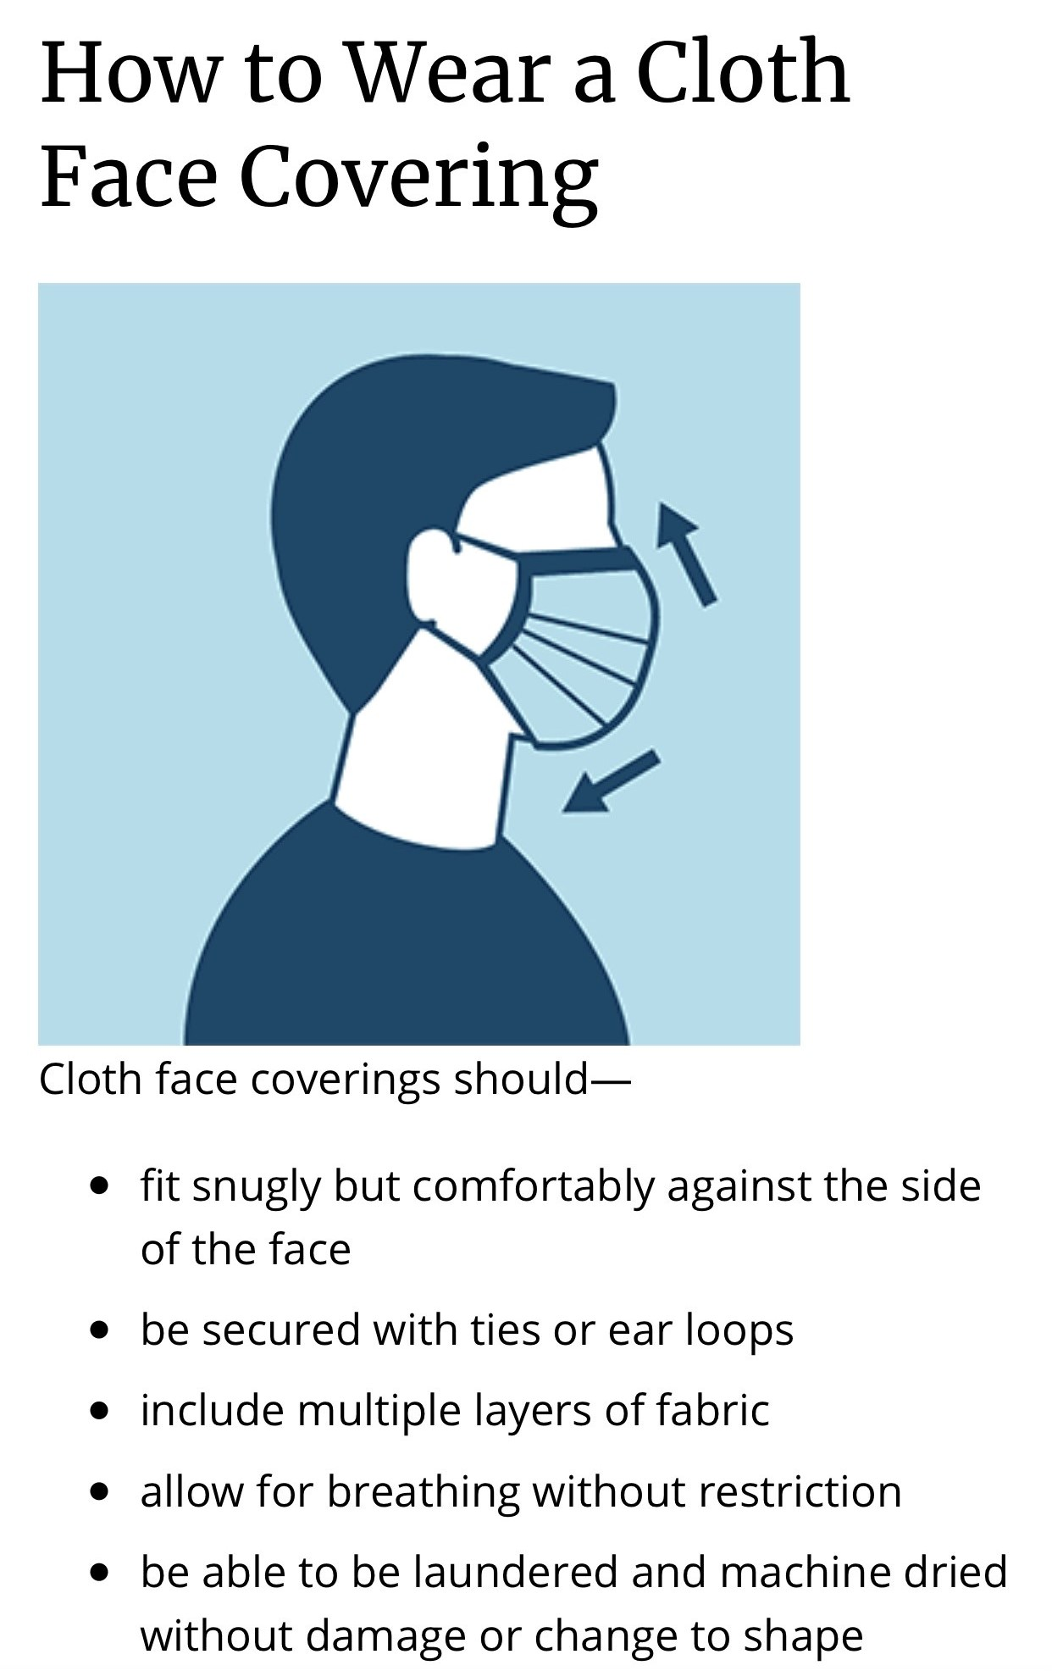
Source: CDC // See more information on the CDC website
See the Trinity Health Personal Protective Equipment Guide for additional mask information

Slide 13
Hand Hygiene
Practice good hand hygiene:
Use hand hygiene after removing your face covering
Avoid touching or rubbing eyes, nose, and mouth
Avoid handshaking, hugs, and fist bumps with others
Be mindful of what you touch, especially if you have touched surfaces that are touched frequently by colleagues, e.g., handrails, doorknobs, elevator buttons, copy machines, etc.
Always wash hands before and after eating, after using the restroom, etc.
Use paper towel to turn off restroom faucets, opening restroom door

Slide 14
Hand hygiene methods
Follow one of these hand hygiene methods:
Wash hands with soap and water for at least 20 seconds
Use hand sanitizer with at least 60% alcohol and rub onto hands until the sanitizer dries (preferred method)
If you bring your own hand sanitizer into the building, it must be listed in the MSDSOnline database for Trinity Health and a Safety Data Sheet (SDS) must be available through the MSDSOnline database. See the guide for more information.

Slide 15
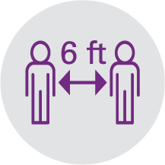
Physical-Distancing Practices
It is important that you continuously strive to put six feet of physical distance between yourself and other people.

Slide 16
Physical-Distancing Practices
Stairwells, Elevators and Corridors
If possible, take the stairs instead of the elevator.
Some stairwells may be designated to single direction (Up Only or Down Only).
Follow all posted directional signs. In the case of building evacuation, either due to a routine life safety drill or actual emergency, all stairwells will be used for exiting.
While taking the stairs, maintain six feet of physical distance from the person in front of you.
Do not congregate on the stairs or the landings.
Elevator occupant capacity will vary based on the size of the cab.
Follow all posted physical distancing signage in the elevator lobby and elevator cab.
Some corridors may be designated as single direction. Follow all posted directional signs.
In the case of building evacuation, either due to a routine life safety drill or actual emergency, all corridors will be used for exiting.
While using corridors, both single direction and dual direction, strive to maintain 6 feet of physical distance from other people.
Follow face covering requirements as described in the face coverings section above.
Complete hand hygiene after using the stairwell, elevator or corridor, using the available hand sanitizer dispensers or soap and water.

Slide 17
Physical-Distancing Practices
Meeting & Common Areas
Even while in the office, use virtual meetings to limit in-person meetings.
If in-person meetings must take place, limit invitees to no more than ten people while still maintaining the six-foot physical distance between people. Small conference rooms and enclaves may be limited to single occupancy.
Maintain six feet between colleagues in cafeterias, kitchenettes, collaboration spaces and other areas.
Face coverings must be worn in all public or shared spaces, including meeting rooms, even when physical distancing can be achieved.
Offices and Workstations
Department offices and workstations will remain in the layout configuration.
Shared offices and workstations will be used as single occupancy.
To achieve physical distancing in open work environments, some colleagues will be assigned new workstations. Other workstations will be block or labeled “not for use.” The reason for this is to maintain 6 feet of physical distancing between colleagues while at their assigned station.

Slide 18
Cleaning & Disinfection
Cleaning & Disinfection Plan
A cleaning and disinfection plan for the building is in place and aligns with the CDC, OSHA, any state and/or local authorities. Please contact your supervisor with any questions.
Janitorial Services
The janitorial colleagues will clean and disinfect the building entry, public and common areas of the building as defined in the cleaning and disinfection plan.
Colleague Self-Sanitizing
You have an important role in keeping your work space and common areas clean, disinfected and safe. Colleagues are required to complete the following self-sanitizing protocol.
Cleaning and disinfecting supplies will be made available for colleague use.
If you bring your own disinfectants or cleaners into the building, they must be listed in the MSDSOnline database for Trinity Health and a Safety Data Sheet (SDS) must be available through the MSDSOnline database. If the SDS is not available, the product is not allowed in your work space. Access MSDSOnline. See the guide for more information.

Slide 19
Colleague Self-Sanitizing
Office/Workstation | Meeting & Collaborative Areas | Kitchenette/Breakroom
At least 2x daily, wipe down the frequently touched equipment, furniture, and finishes. Follow the cleaning directions below to protect your equipment. | Prior to the beginning and at the end of the meeting, participant(s) wipe down the table top, the chair backs/arms, and devices (remotes, markers, phones, etc.) touched or used during the meeting. Remember to practice hand hygiene after all meetings. | Wipe down all appliance handles (microwave, refrigerator, sink, etc.) before and after use. Remember to practice hand hygiene after using common areas.

Slide 20
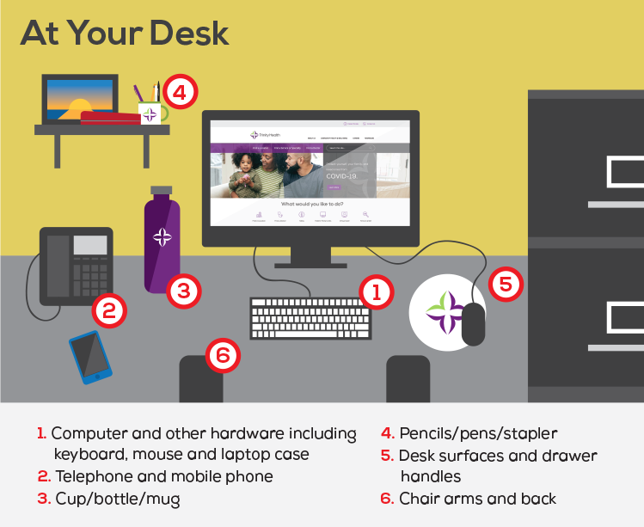
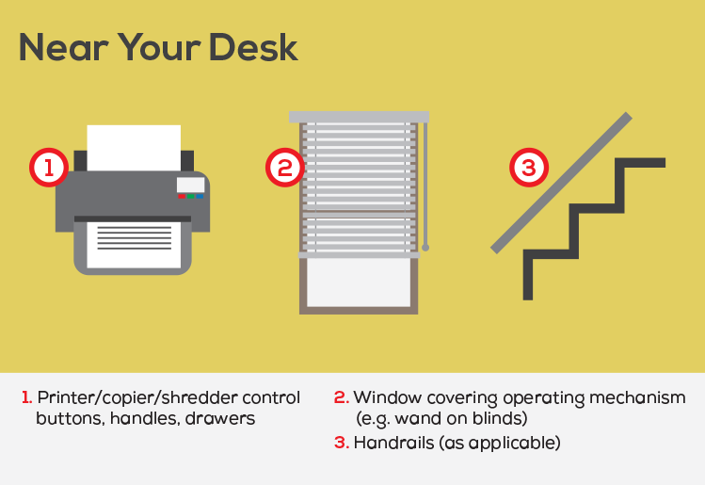
Your workspace: Clean the following items twice daily

Slide 21
How to clean your keyboard, monitor and PC safely
Extra care should be taken when cleaning sensitive electronics including your keyboard, mouse, laptop PC and monitors to prevent damage.
Do not spray cleaning solution directly on your keyboard. Instead, lightly moisten a microfiber cloth with the solution and wipe gently.

Slide 22
Resources
If you have questions or concerns about our work environment, please contact me.
Other Resources:
Trinity-Health.org/Colleague-Care
Carebridge, our employee assistance partner, is a 24/7, confidential resource, providing counseling, information and referral services to help address personal, family and work-related concerns. Call 1-800-437-0911 or visit MyLifeResource.com (use code BKKR5 to create a personal login)

Slide 23
Thank you for your commitment to safety and our Mission.

