Slide 1
Colleague Care National Check-in
October 29, 2020

Slide 2
Welcome – Colleague Care National Check-in
kp
Thank you for joining us today! We will begin momentarily.
Please keep your Mic on MUTE when you are not speaking to minimize background noise.
If you are calling from a facility phone, please do NOT put us on HOLD - we will hear your hold music or messages.
We invite you to use your video camera if you have one as we begin and when you are speaking
If you have a question or comment, please let us know by speaking or by using chat feature.
This meeting is being recorded.
The link to recording and slides will be sent to you following our Check-in.

Slide 3
Today’s Agenda
kp
Time (ET) | TOPIC | LEAD
12:30 pm | Welcome Agenda Review Reflection ­­­­ | Kelly Putnam (kp), Director, Organization Effectiveness Mario Brunetta, VP Mission Integration
12:40 | Leadership Update | Dr. Tom Peterson, Chief Safety Officer
12:50 | Featured Presentations: Physician Resilience | Dr. Milene Argo Rev’d Fr and Dr. Kirtley Yearwood
1:40 | Task Force Updates | Communication – Jody Lamb, Manager, Communications; Resource Reminder – Tiana Samuels, Consultant, Total Rewards/Benefits Miscellaneous Notes
1:55 | Open Forum
2:00 | Adjourn

Slide 4
Reflection Mario Brunetta Vice President, Mission Integration Trinity Health System Office

Slide 5
Reflection
You can tell when a trip is long because you start setting goals to make your progress…. Maybe it is a sign of fatigue, but I believe many of us are counting days now and watching for a new year. But I would tell you one thing: if I had to live through this long march through COVID-19, I could not ask for anything better than to make the trip with you. Seeing you here each day has kept me going. Just when I thought I was ready to sit down and give up, I would catch a glimpse of you helping others along the way and I would regain my strength. I know we will make it because you are showing the way. Not by counting days, but by caring for those around you. You embody an ancient truth known to any spiritual traveler: It is not how far we walk on our own, but how well we walk together that matters.
(Adapted from Steven Charleston)

Slide 6
Opening Comment Tom Peterson Chief Safety Officer

Slide 7
Opening Comment
Thank you for your commitment to colleague well-being
Over 10,000 1:1 Resiliency Rounding interactions so far!
Emergence Team 7 – focus on Safety and Zero Harm
Colleague Care task force positioned as sub-team
Welcome new Task Force member!
Rachel Handler, Executive Director, Behavioral Health and Rehabilitation, St. Peter’s Health Partners
Introduce our guest speakers

Slide 8
Featured Topic Physician Resiliency

Slide 9
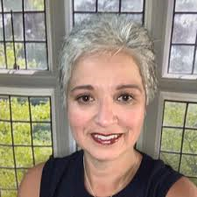
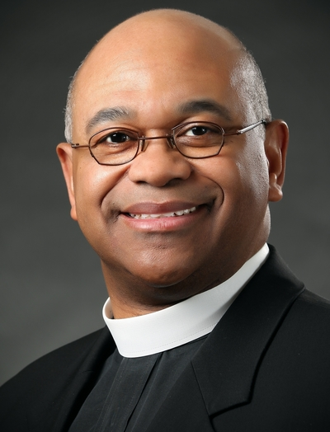
Our guests today…
Dr. Milene Argo
St. Mary’s Medical Group, Athens, GA
My Journey Toward Resilience
Reverend and Dr. Kirtley Yearwood
Holy Cross, Silver Spring, MD
Resiliency Rounding for Physicians

Slide 10
Task Force Updates: Physician Wellness
VA
Notes:
Appreciation to team for their positivity, focus, engagement during the pandemic and throughout our OE and WPHRA transformation. Reference $600 Appreciation Award coming in November.

Slide 11
Communications: Upgraded Colleague Care website
Trinity-Health.org/Colleague-Care
National resource for all colleagues
Now moving forward with enhancements
Updating from single page to microsite, Inspired by the National Health Ministries’ resource
Your insight is needed and appreciated as we define content
By 11/6, you’ll receive email with information and survey link to provide feedback
Expected site launch date: no later than 12/1

Slide 12
Resource Reminder!
All-colleague facing page:
https://www.trinity-health.org/colleague-care/
Colleague Care Team page:
https://www.trinity-health.org/covid-19-resources/find-a-resource/colleague-care-leader-resources/

Slide 13
Miscellaneous Notes…
Link to recording and slide deck from Dr. Bryan Sexton’s October 28 Webinar on Bite-Sized Coping for Physicians and Providers
https://trinity-healthevents.webex.com/trinity-healthevents/lsr.php?RCID=8cf2630a6792b8fcea310fca4d43cef6
Password hVCPSMj9
Colleague Care Notes – moving to bi-monthly cadence
Next Colleague Care National Check-in: November 17
Reminder to let your liaison know or reach out to Becky Hoerner with any updates to AE and Coordinator roles

Slide 14
Open Forum Q&A
kp

Slide 15
Appreciation and Adjourn

